Slide 1
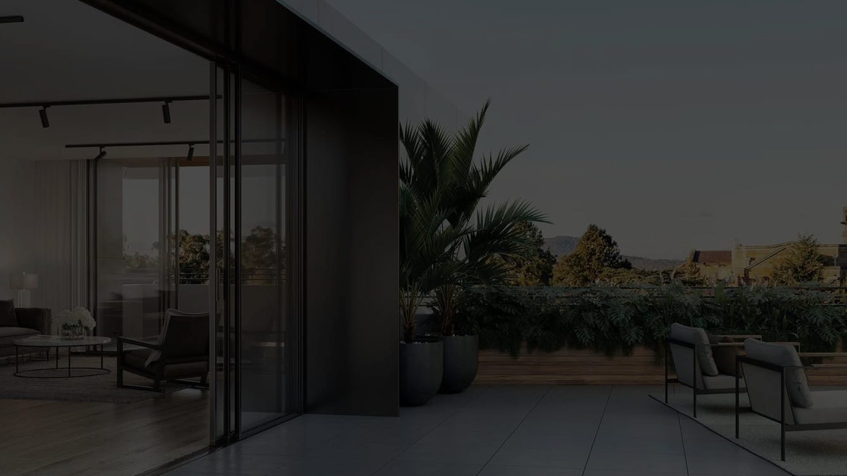


www.co-architecture.com

Slide 2












LOGO
CO-architecture is an Australian technology startup founded by architects and designers. Our platform connects and empowers the largest network of Independent and Job-Seeking design professionals across Australia with a growing suite of powerful employment features.
A smarter way to work, build your career and take your business to new heights As a dedicated network of architecture and design professionals, our platform allows people to connect, contract or hire, whether permanent, temp-perm, or on a casual/project by project basis.

Slide 3
COLOURS
Colour is the visual perception of different wavelengths of light by the human eye. It is an essential element of design, art, and communication, and has a significant impact on our emotions, moods, and behaviour.
#000000
#F2F6F0
#FCFCFC

Slide 4
TYPOGRAPHY
TYPOGRAPHY
Inter
Typography is the art and technique of arranging type to make written language legible, readable, and appealing when displayed. It involves choosing typefaces, point sizes, line lengths, line-spacing, and letter-spacing, among other things, to create visually appealing and effective communication.
Bold
ABCDEFGHIJKLMNOPQRSTUVWXYZ
abcdefghijklmnpqrstuvwxyz
0123456789
Regular
ABCDEFGHIJKLMNOPQRSTUVWXYZ
abcdefghijklmnpqrstuvwxyz
0123456789

Slide 5
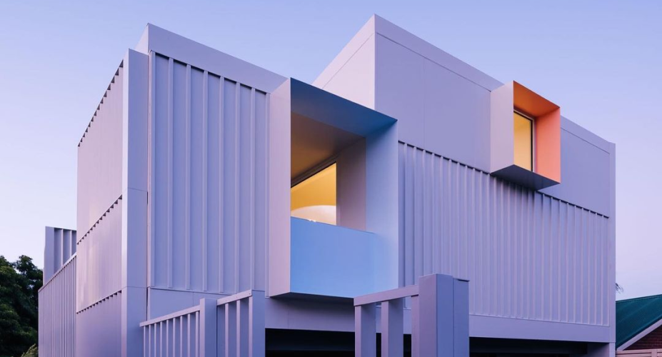
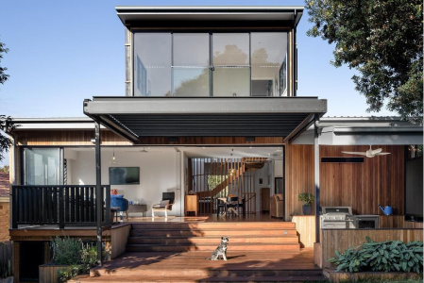
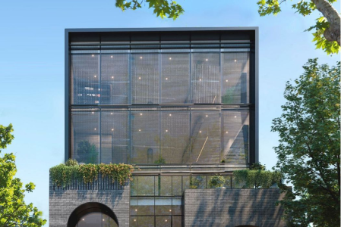
IMAGERY
Imagery is visual symbolism, or figurative language that evokes a mental image or other kinds of sense impressions, especially in a literary work, but also in other activities such as psychotherapy.

Slide 6
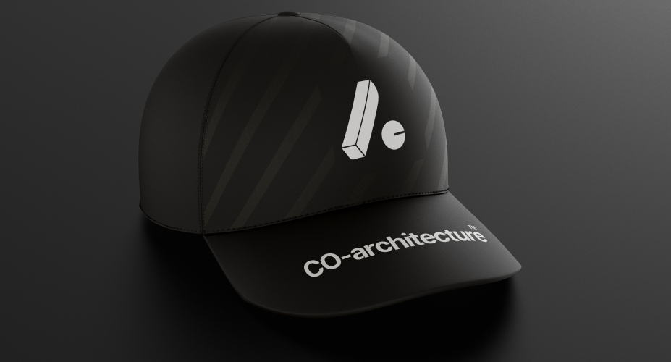
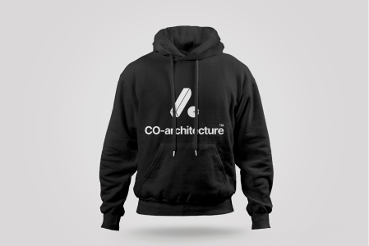
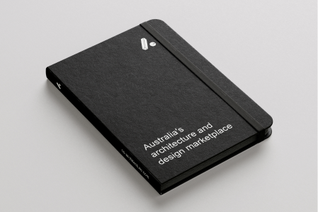
MARKETING
Marketing is the process of promoting, selling, and distributing products or services to a target audience. It involves identifying customer needs and wants, developing a marketing strategy to meet those needs, and communicating the value of the product or service to potential customers.

Slide 7


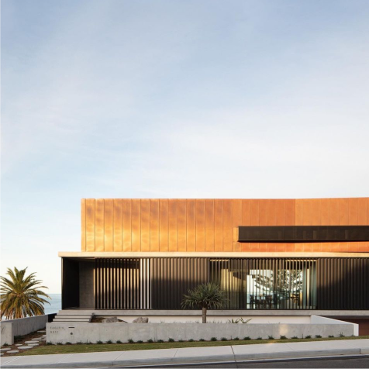


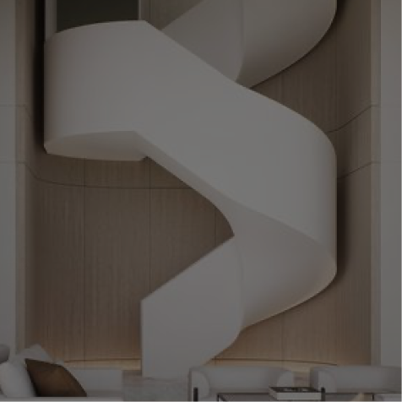


_coarchitecture
Sydney, Australia
www.co-architecture.com
_coarchitecture
CONNECT EMPOWER BUILD
Sydney, Australia
Australia's architecture & design marketplace
DESIGN

